Slide 1
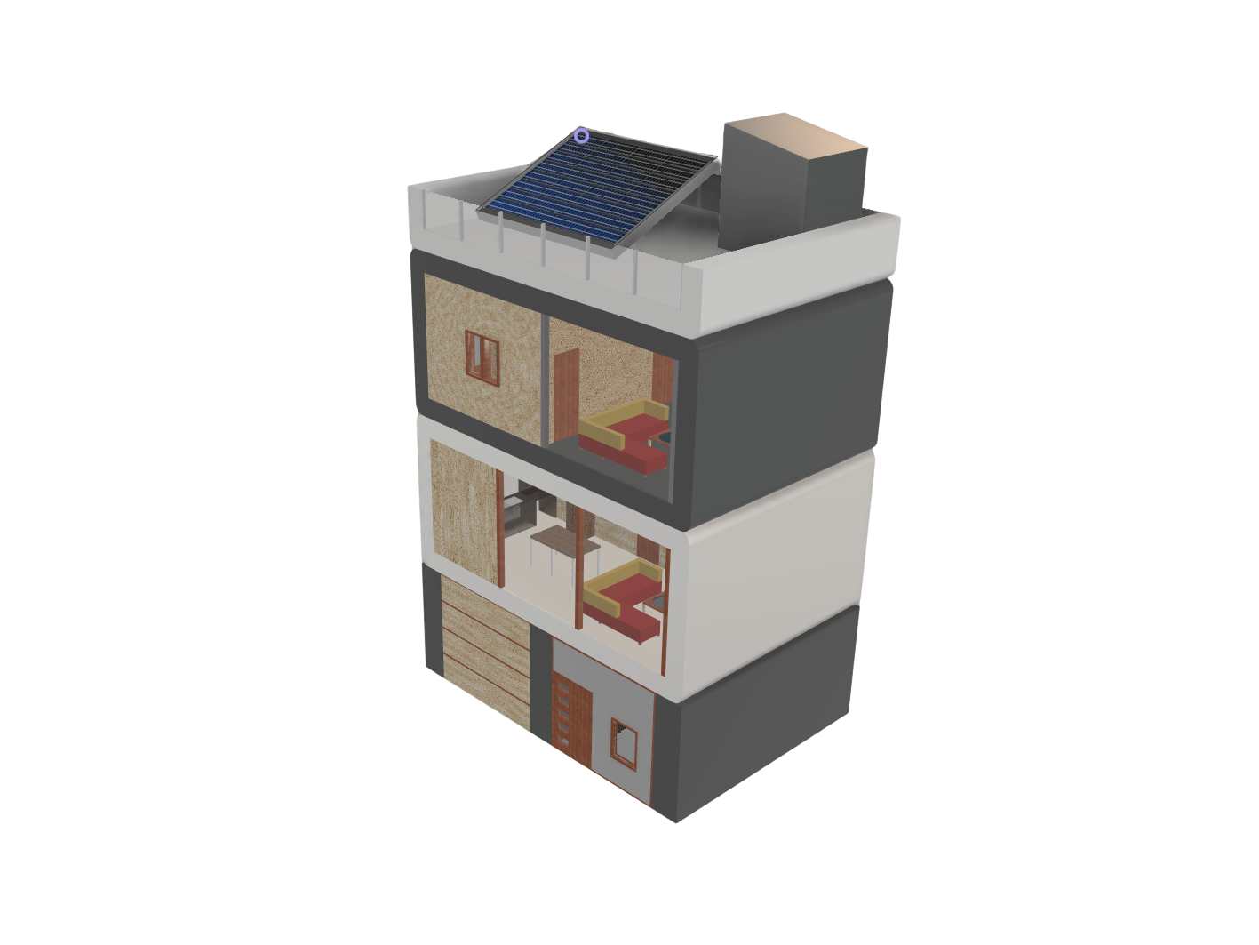
ENERGY EFFICIENT
BUILDING
ENERGY EFFICIENT
BUILDING
Team - Bhole Chature
Sustainable Building

Slide 2

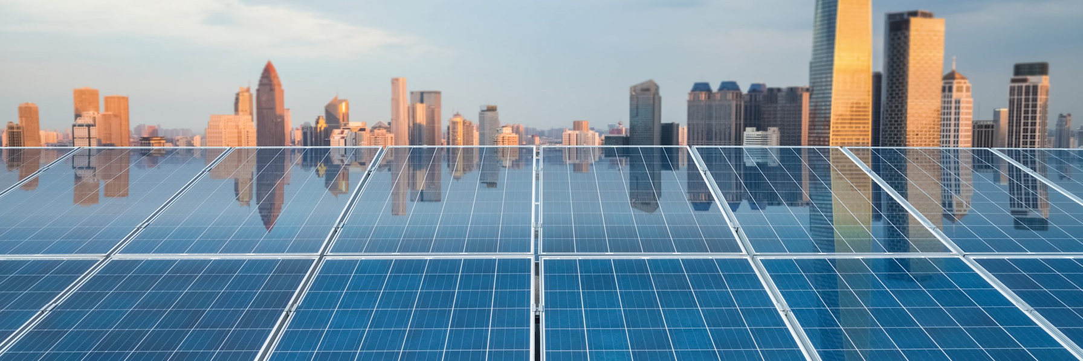
INTRODUCTION
"In a world facing climate change and rapid urbanization, the need for sustainable architecture has never been greater. Our proposal presents an innovative energy-efficient building that harmonizes with nature, minimizes resource consumption, and maximizes environmental benefit."
Through intelligent design choices, use of renewable energy, and eco-friendly materials, we aim to create a building that is not just functional but beneficial to the environment. Our proposal stands for all sorts of industrial, commercial and household infrastructure in a semi-polluted urban city outskirt location.
Team - Bhole Chature
Sustainable Building

Slide 3
OUR PLAN
Layered Wall Facade
Smart Solar Panels
Our plan focuses on creating a self-sustaining, environmentally responsible building that integrates smart design with natural processes. By optimizing energy use, promoting greenery and utilizing natural resources, we aim to significantly reduce the building's ecological footprint.
Every element of our design prioritizes long-term sustainability, cost-effectiveness, and harmony with the surrounding environment ensuring that our building not only serves its occupants efficiently but also contributes positively to the planet.
Moss Walls
Rainwater Harvesting
Team - Bhole Chature
Sustainable Building

Slide 4
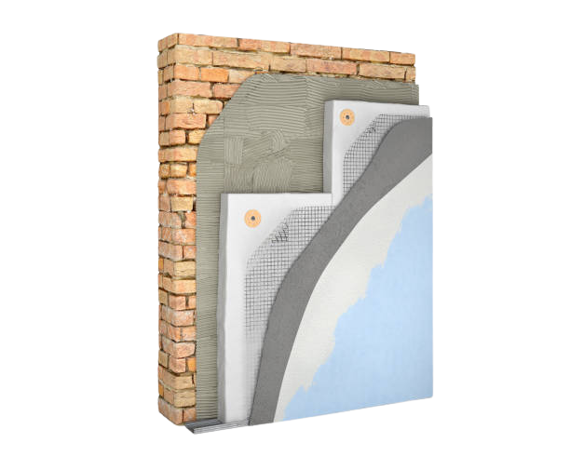
LAYERED WALL
FACADE
A double-skin facade (DSF) consists of two layers of wall separated by an air cavity, enhancing a building's thermal insulation and energy efficiency. Studies have shown that DSFs can reduce energy consumption significantly; for instance, a study in Hong Kong demonstrated a 26% annual saving in cooling energy compared to conventional facades. An exemplary application is seen in the Tower at PNC Plaza in Pittsburgh, USA, which features a fully automated DSF as part of its natural ventilation system, contributing to the building's net-zero energy performance during certain seasons.
Team - Bhole Chature
Sustainable Building

Slide 5

SMART SOLAR
PANELS
​Auto-tracking solar panels adjust their orientation throughout the day to follow the sun's path, maximizing solar exposure and energy capture. Compared to fixed panels, single-axis trackers can increase energy output by 20–35%, while dual-axis systems can boost it by 30–45%, depending on location and design .​
This technology is widely adopted in large-scale solar projects; for instance, in the U.S., 94% of new utility-scale PV capacity in 2022 utilized single-axis tracking systems . The increased energy yield from tracking systems enhances the efficiency and profitability of solar installations, making them a valuable component in sustainable building designs.
Team - Bhole Chature
Sustainable Building

Slide 6
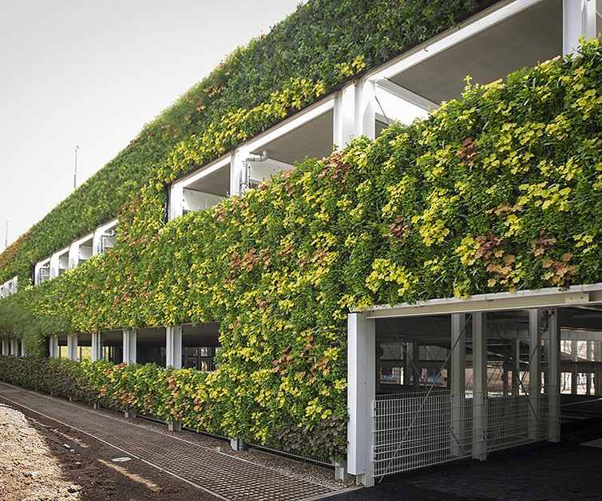
MOSS WALLS
​Moss walls, also known as green walls, serve as natural insulators, effectively regulating building temperatures. They provide shade and absorb heat, reducing the surface temperature of building facades. For instance, Greencity Solutions' CityTree installations have demonstrated that moss surfaces can be up to 14.3°C cooler than surrounding areas, significantly mitigating the urban heat island effect. This passive cooling reduces the reliance on air conditioning, leading to energy savings and a more sustainable building design.
Team - Bhole Chature
Sustainable Building

Slide 7
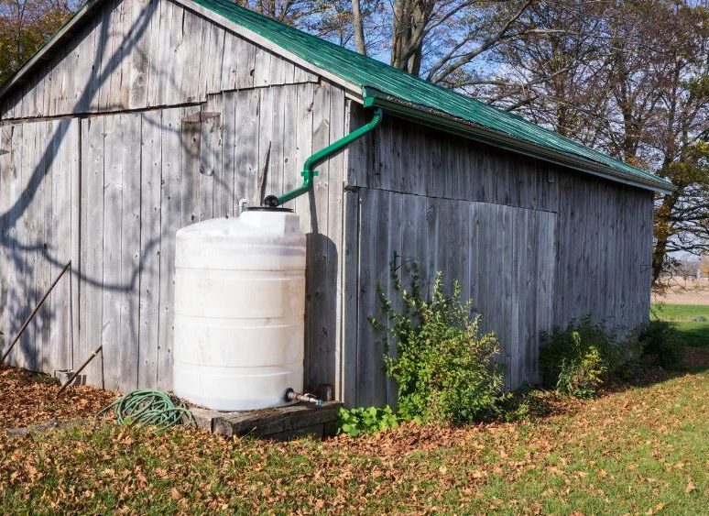
RAIN WATER
HARVESTING
Reduces Energy Consumption
Enhances Cooling Efficiency
Lowers Utility Costs
By lessening reliance on energy-intensive municipal water treatment and distribution systems, rainwater harvesting contributes to significant energy savings.
Utilizing harvested rainwater in building cooling systems, such as cooling towers, can improve efficiency and reduce the need for chemical treatments, thereby extending equipment lifespan.
Collecting and using rainwater for non-potable applications like irrigation and flushing toilets decreases dependence on municipal water supplies, leading to reduced water bills.
Team - Bhole Chature
Sustainable Building

Slide 8
ESTIMATED COST
Feature | Unit | Cost Range (INR) | Details
Layered Wall Facade | 50 sq. ft. | ₹75,000 – ₹1,00,000 | Utilizes cost-effective materials with basic insulation.
Smart Solar Panels | 1 kW system | ₹60,000 – ₹80,000 | Includes panels, inverter, and installation; subsidies may apply.
Moss Walls | 30 sq. ft. | ₹18,000 – ₹24,000 | Preserved moss panels requiring minimal maintenance.
Rainwater Harvesting | 1,000L system | ₹5,000 – ₹7,000 | Basic system with storage tank and filtration.
Estimated Total Cost: ₹1,58,000 – ₹2,11,000
Estimated Total Savings: ₹5,56,875 – ₹8,56,875

Slide 9

ENERGY
SAVINGS
CO₂ Emissions Reduction: Approximately 33,200 – 37,500 kg (based on 0.8 kg CO₂ per kWh).
Equivalent to: Planting around 1,100 – 1,250 trees or removing 7 – 8 cars from the road for a year.

Slide 10
SUBTLE FEATURES
Bigger WIndows
Using Fly Ash Bricks
Maximizes natural daylight & reduces dependence on artificial lighting
Made from industrial waste, reducing carbon footprint and enhancing strength
Indoor Plants
Light-colored Exterior Walls
Adds natural freshness, improves air quality, and promotes sustainable lifestyle
Reflect sunlight to reduce heat absorption, helping maintain indoor temperature

Slide 11


Slide 12
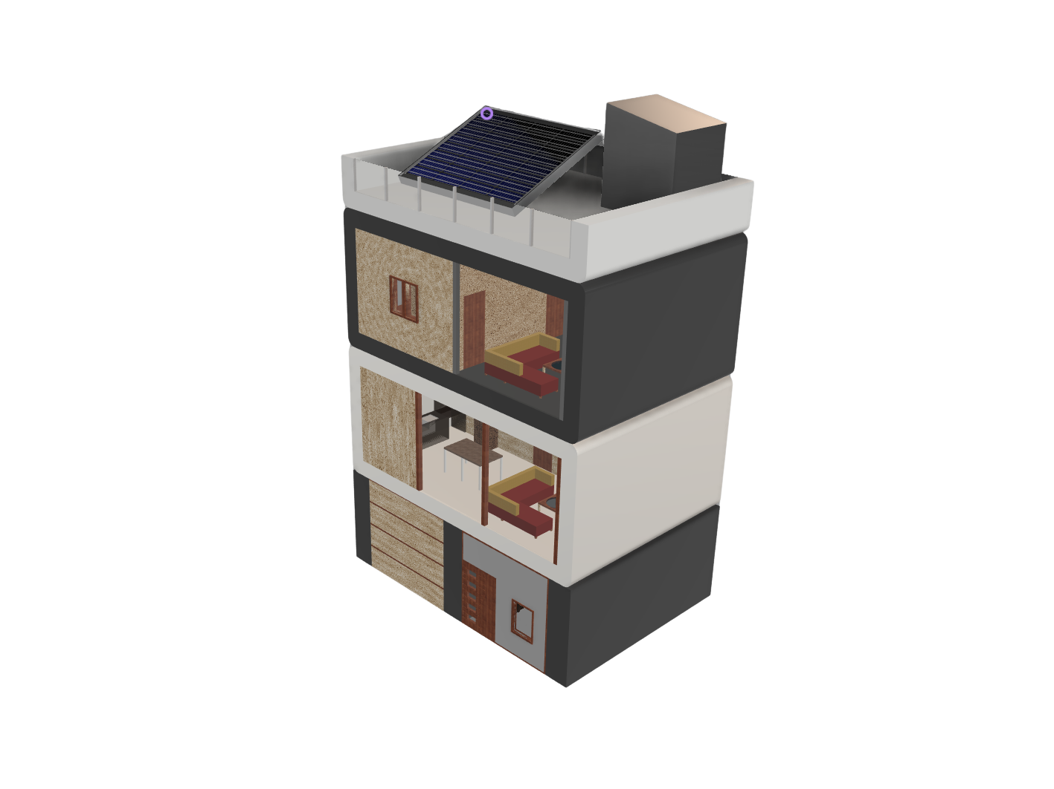
THANK YOU
THANK YOU

